Slide 1
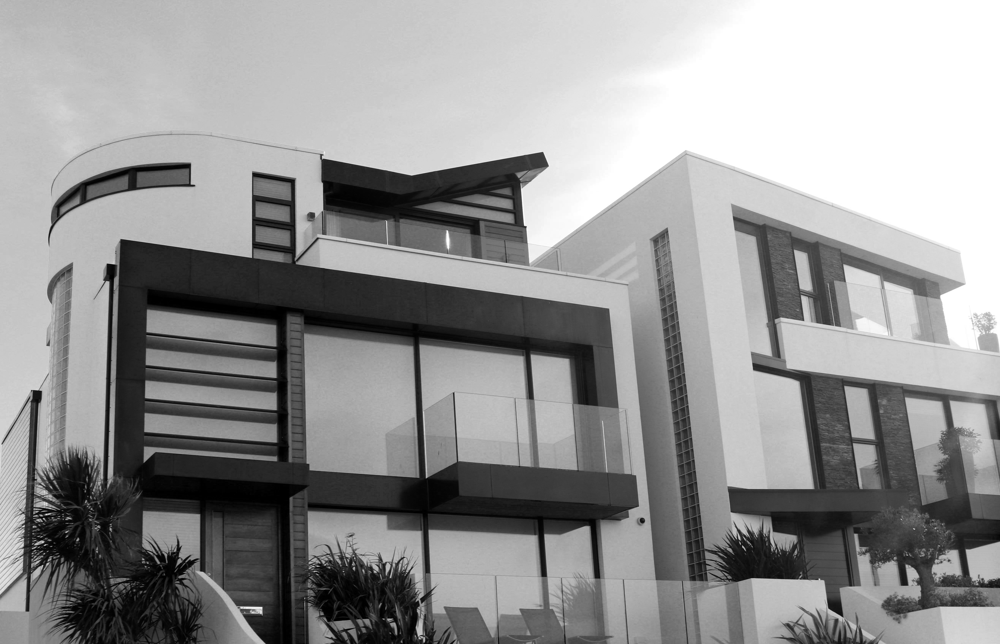

HouseCom™ ThermoSecure™ Brand Guidelines
How to apply the HouseCom™ Brand identity
consistently and effectively
October 2018

Slide 2

Table of Contents
Introduction 3
Brand Characteristics 4
Commonly used terms 6
Logo Elements
Colour Study
Typography Study

Slide 3
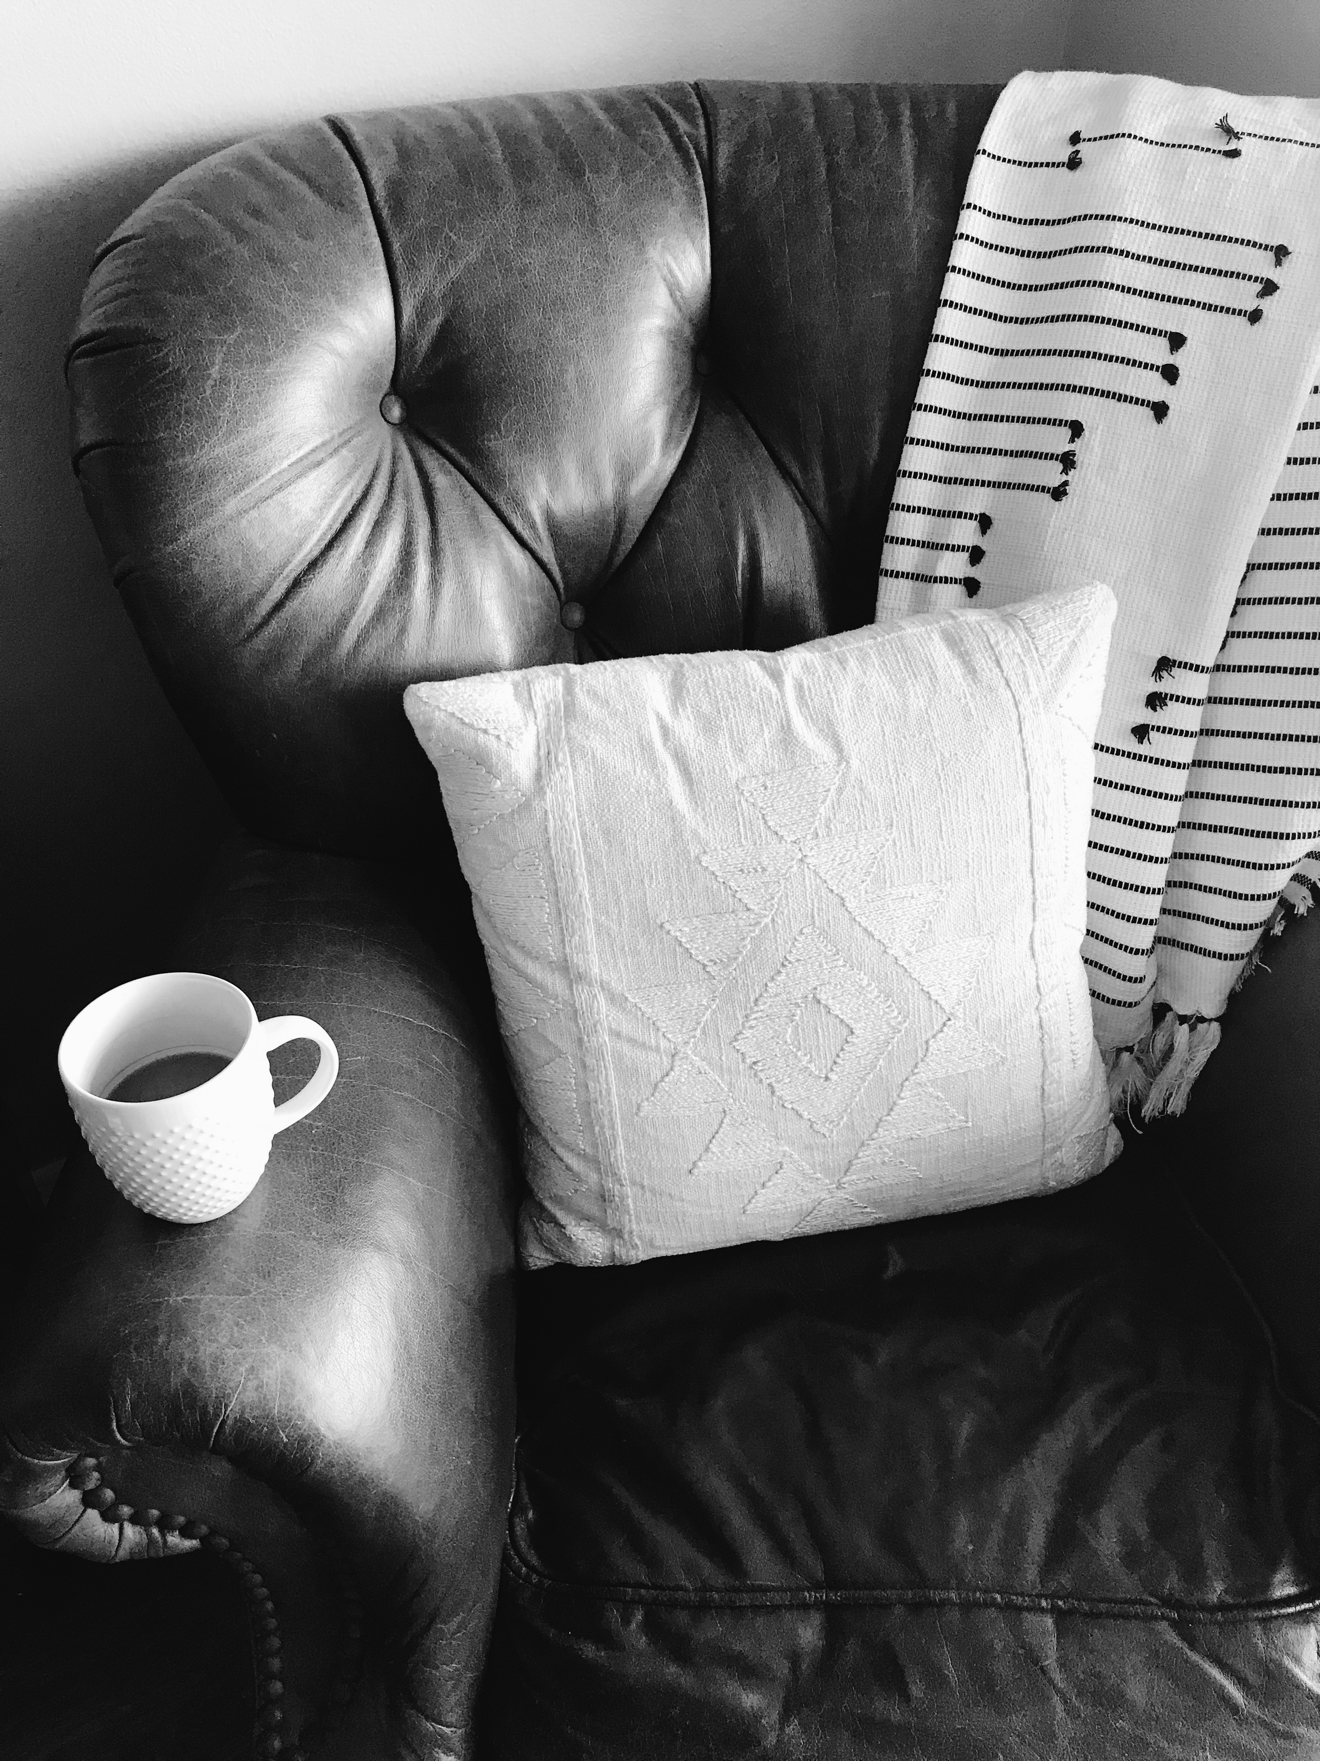
Introduction
Brand Guidelines are a set of rules that explicitly explain how our brand works. These guidelines are to be followed in all communications to ensure there is a consistent and unified representation of the HouseCom™ brand.
This guide covers all components of the design system, how and when to use them, appropriate variations and acceptable vs unacceptable uses. This guideline will make the production of materials easier, quicker and more effective and, in turn, will assist to maintain our brand strength.

Slide 4
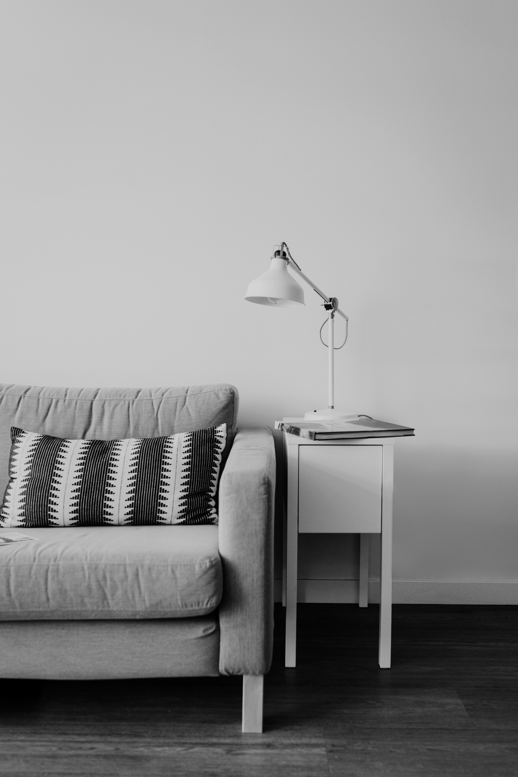
Brand Characteristics
There are various characteristics that define the HouseCom™ brand. Below contain the most prominent characteristics of our brand:
Intelligence
Sophisticated
Innovative
Modern

Slide 5
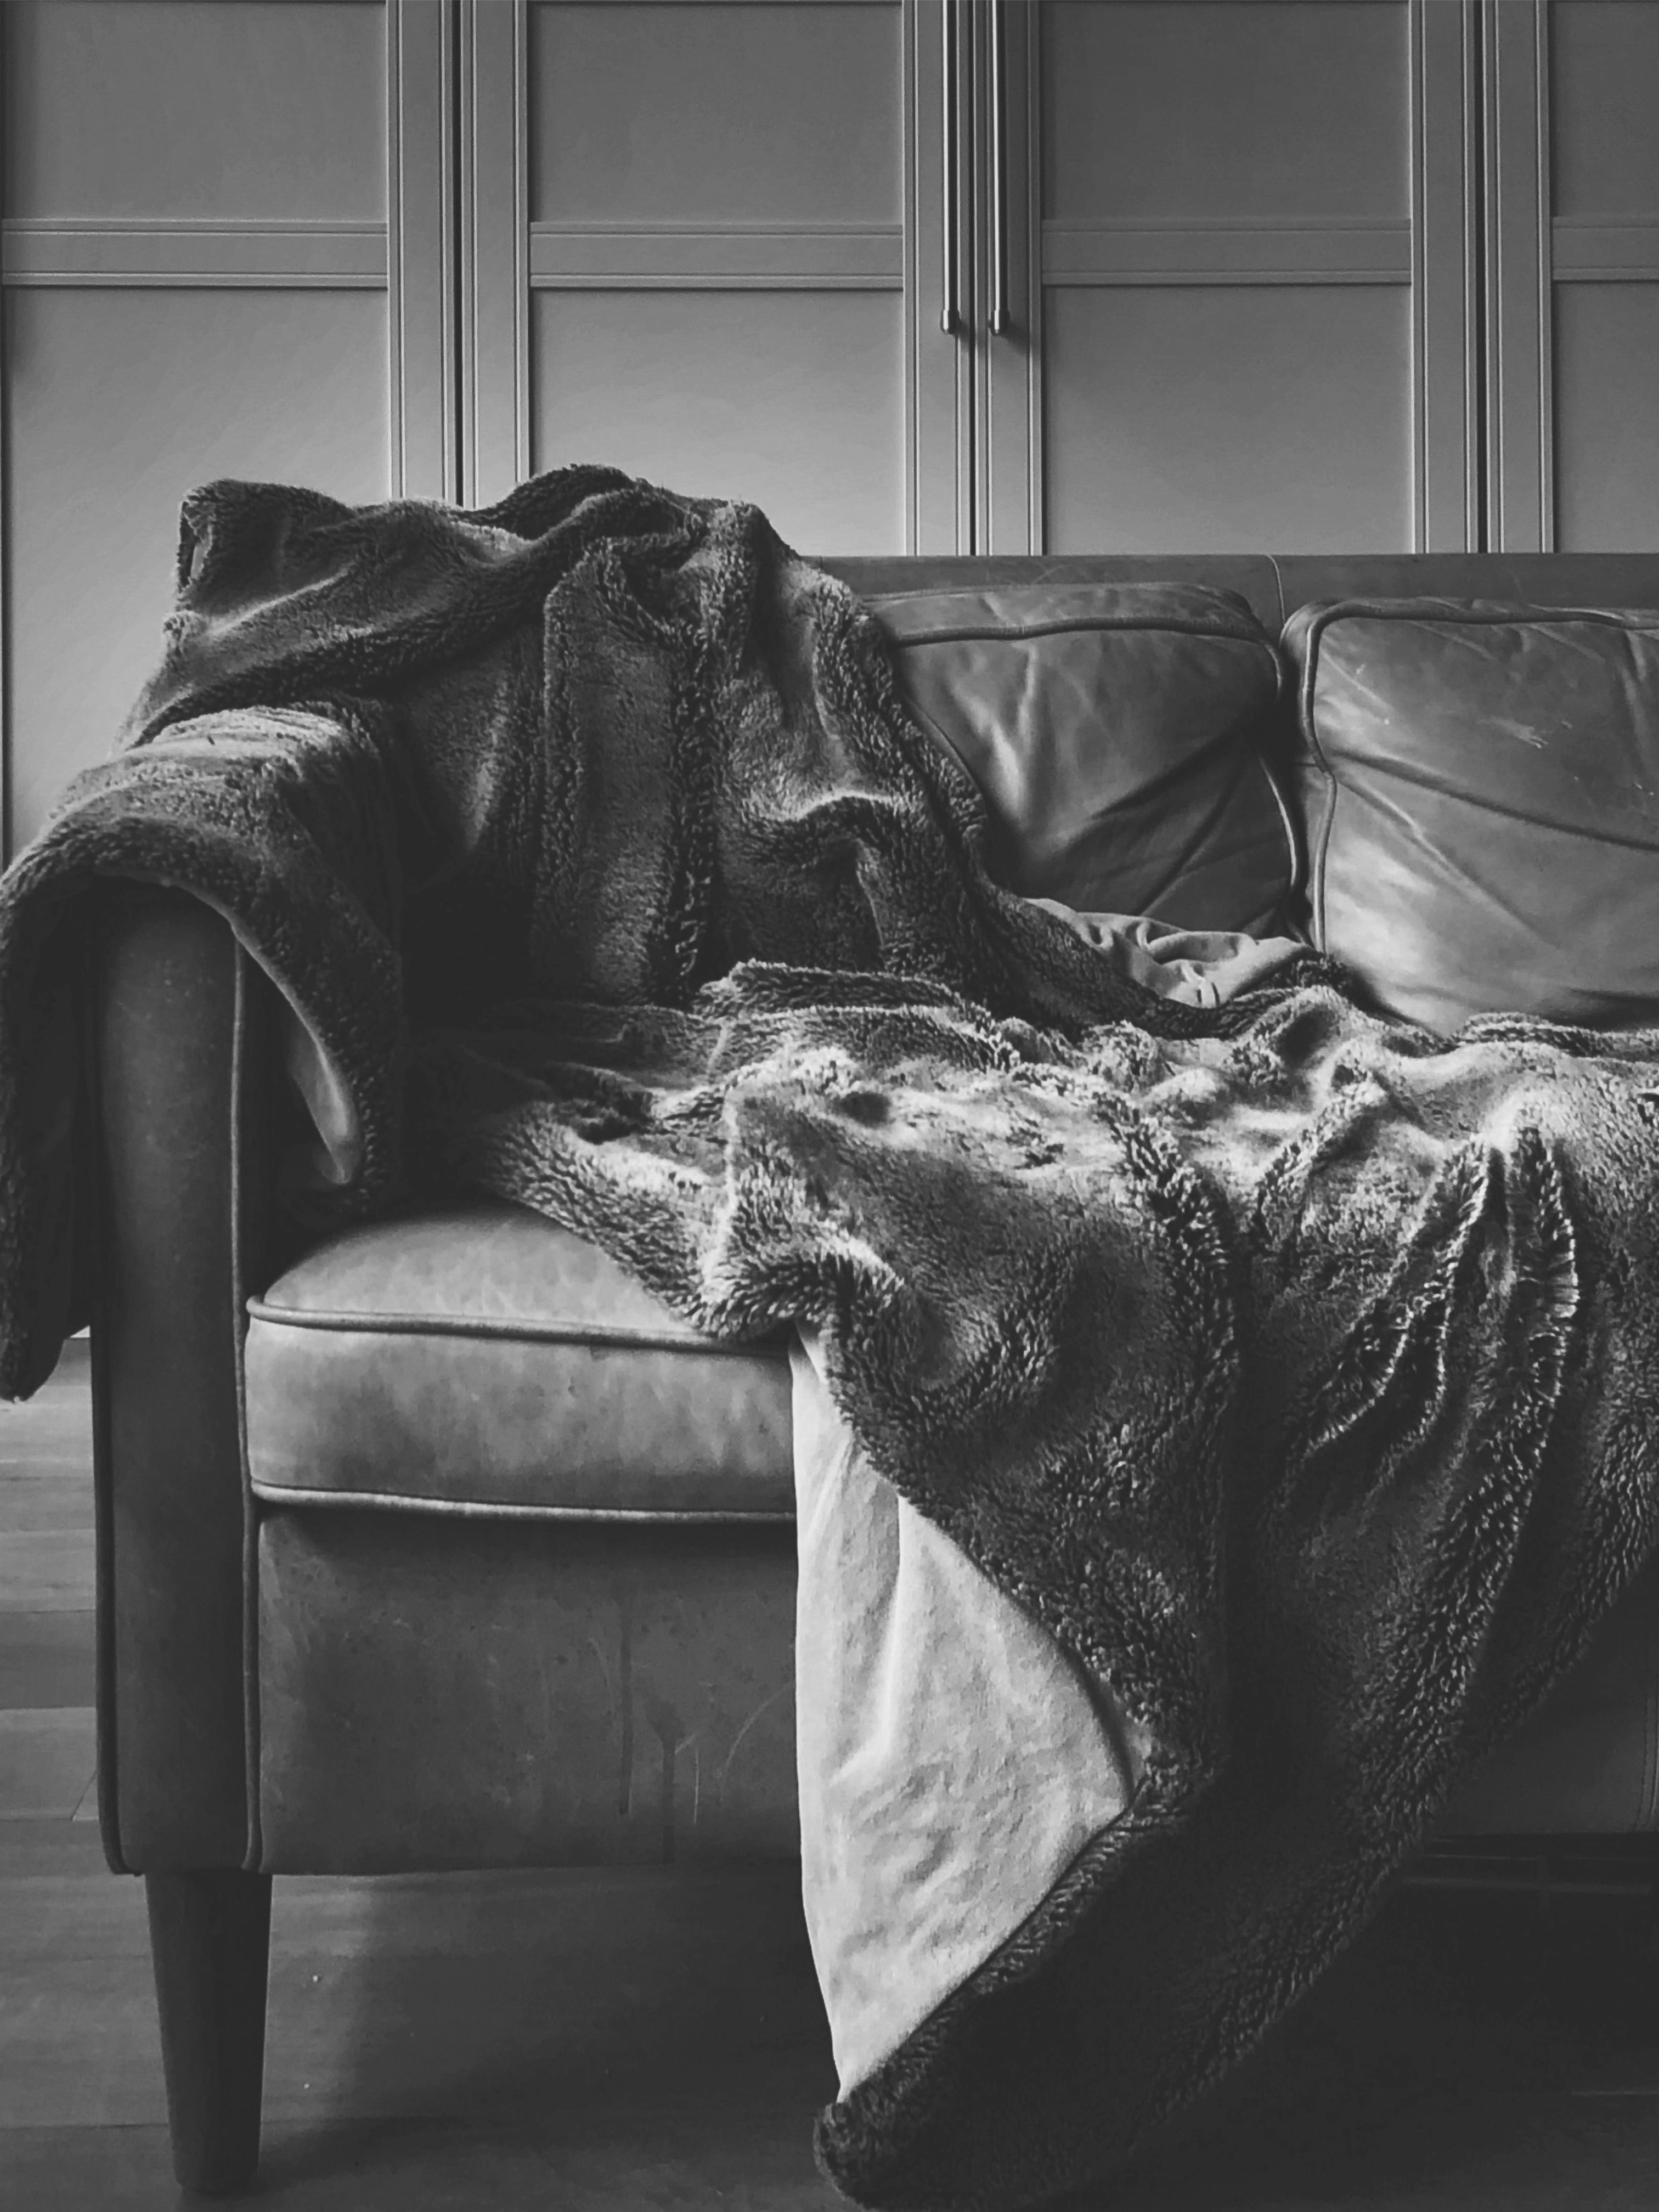
Logo Elements

Slide 6

Logo Elements
The elements
HouseCom™ ThermoSecure™ is identified by its corporate logo, which is comprised of half a blue snowflake icon and half a red sun icon. This logo effectively captures the HouseCom™ characteristics and perfectly captures what the company stands for: innovation, modernity, and intelligence. The preferred HouseCom™ logo is shown on this slide and is not intended to be drawn in any other manner.

Slide 7
Logo Elements

Slide 8
Colour Study
Baby Boy Blues®
CMYK C 12 M 1 Y 0 K 18
RGB R 183 G 206 B 208
The HouseCom™ visual identity uses three main colours: red, blue and black. These create the primary colour palette.
When Pantone® inks are not applicable, the following breakdowns should be used: For 4-colour process printing, refer to the CMYK values shown here. For on-screen and web applications (e.g. PowerPoint®, websites, video and intranets), refer to the RGB values specified.
Please use only the colour breakdowns provided here.
Warm Red®
CMYK C 0 M 55 Y 60 K 80
RGB R 209 G 94 B 84
Black
CMYK C 0 M 0 Y 0 K 100
RGB R 0 G 0 B 0

Slide 9
Typography Study
Type family
Helvetica is the only typeface used in the HouseComm™ company identification logo. Any other replacements fail to justly represent the company and are prohibited. However, should Helvetica not be available, Avenir Light may replace it – but, is highly discouraged.
Heads and Subheads
For heads and subheads, Avenir 40 is recommended. Body Copy
Body copy is set in Avenir 35.
Type Colour
All type is expected to be dark grey #4d4d4d. However, on a black background, white #FFFFFF is acceptable.

Slide 10
Any questions about the brand guidelines can be shared with:
Soraya Pittis, Allison Pao, Jaclyn Flomen, Reece Devine, and Jay Vernon

